Slide 1
Reinforcement Learning in Super Mario Bros.
By: Preetham Kollabathula

Slide 2
Outline
1. Problem Statement
2. Reinforcement Learning
3. Open Ai
4. StableBaselines
5. PPO
6. Reward Function
7. Demo
8. Future Enhancements

Slide 3
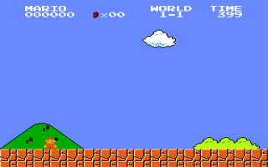
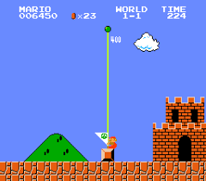
Problem Statement
Traverse the Mushroom Kingdom
Eliminate or avoid enemies
Save Princess Peach

Slide 4

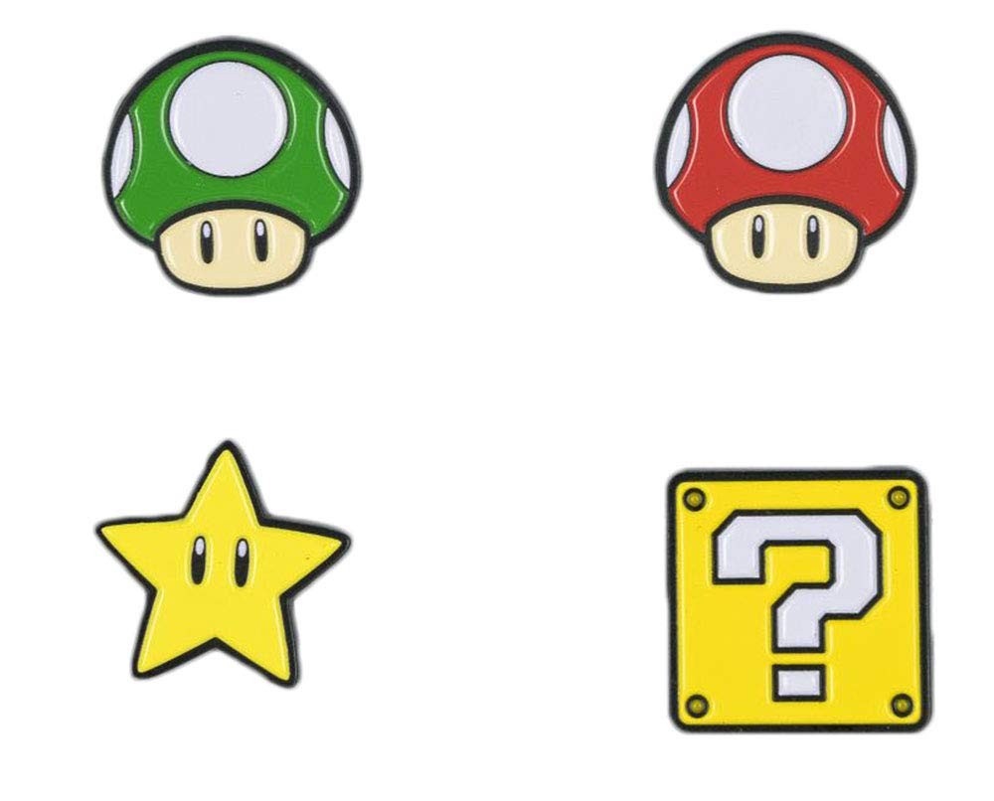
Power-Ups

Slide 5
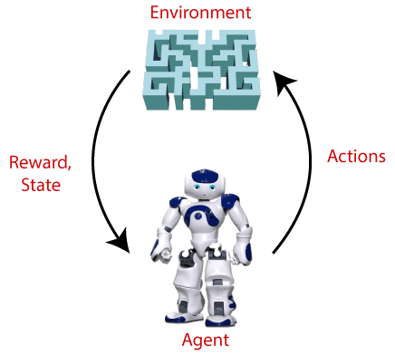
Reinforcement Learning
Definition:
Reinforcement learning is an area of machine learning concerned with how intelligent agents ought to take actions in an environment in order to maximize the notion of cumulative reward.

Slide 6
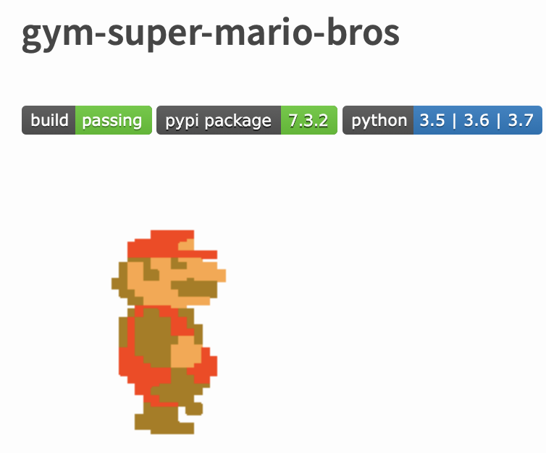
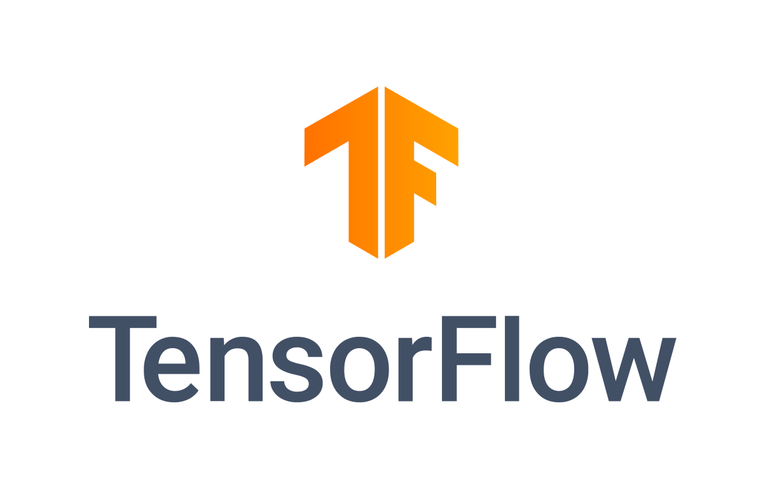

Steps to create the bot
1. Set up environment
2. Build Deep Learning Model
3. Building neural network for PPO

Slide 7
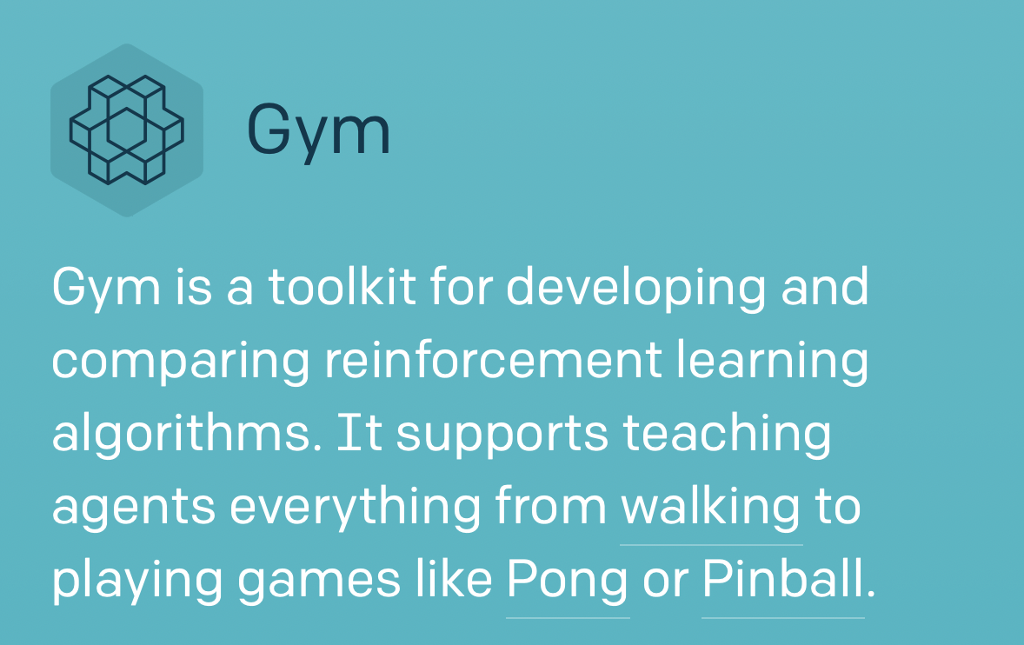
Open AI

Slide 8


Reward Function
= 1 Point
= 0 Points

Slide 9
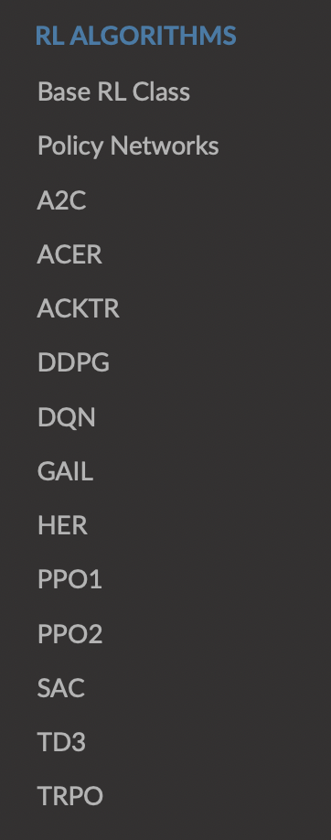
Stable Baselines
Stable Baselines is a set of improved implementations of Reinforcement Learning (RL) algorithms based on OpenAI Baselines.
Github repository:
https://github.com/hill-a/stable-baselines

Slide 10
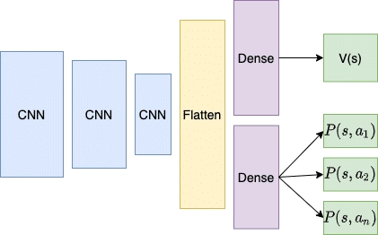
PPO
Proximal Policy Optimization, is a policy gradient method for reinforcement learning.
The motivation was to have an algorithm with the data efficiency and reliable performance of TRPO, while using only first-order optimization.

Slide 11
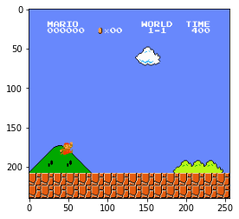
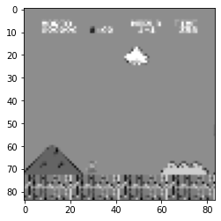
Training the Model
What Human Sees:
What Ai model Sees:

Slide 12
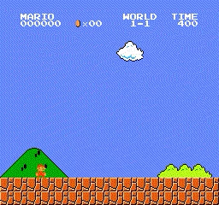
Demo
Training for
50 thousand episodes:

Slide 13

Demo
Training for
5 million episodes:

Slide 14

Demo
Dream RUN!
Training for
9 million episodes:

Slide 15


Future Enhancements
Training Mario using different RL Algorithms and comparing the results using Tensorboard to choose the best algorithm for the game

Slide 16


